Slide 1
MVC (Model-View-Controller)

Slide 2
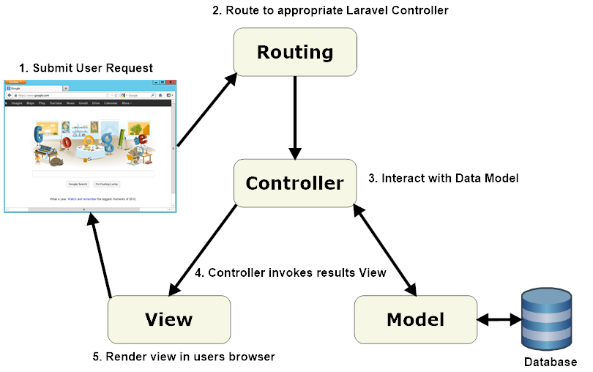
Flujo

Slide 3


1
Modelo

Slide 4
Bases de datos o repositorio de datos y reglas de negocio
Notes:
Used for short header and graphical icon. If you’d like the icon to come on after the text, please add .5s fade build in
4

Slide 5
2
Vista

Slide 6
Blade
Notes:
Used for short header and graphical icon. If you’d like the icon to come on after the text, please add .5s fade build in
6

Slide 7
3
Controlador

